Slide 1



Climate Analytics
EY DA Generic Batch Group-D
Saptashwa Banerjee
Suryasundar Bose
Shiny S Mathew
Neha A
B Sai Rahul Reddy
Boddu Poojitha
C Naga Babu
Mukesh Nandy
Vinay K P

Slide 2

Problem Statement
Near real-time weather information for current and next 5-7 days
Weather Change Year-Over-Year
Impact of Harmful Radiation

Slide 3
Project Process
Data Collection
Collecting Weather Data & Radiation data for all the states of India
Data Pre-Processing
Merging all data to Master Table, Cleaning the data-set, Null handling in Data Bricks
Storing Data
Storing data in Data Lake Gen-2 & connecting Data Lake to DataBricks for analysis
Problem Statement
Execution of problem statements
Visualization
Visualizing the output of problem statements

Slide 4



Technologies Used
Microsoft Azure
Data Bricks & Data Lake
Power BI
Azure is a cloud computing service operated by Microsoft for application management via Microsoft managed data centers.
An open and unified platform for Data Engineering, ML & Analytics.
A data lake is a centralized repository that allows you to store all your structured and unstructured data at any scale.
Unify data from many sources to create interactive, immersive dashboards and reports that provide actionable insights and drive business results.

Slide 5
Near real-time weather information for current and next 5-7 days Analysis
Visualization
API Calling
Visualizing the output of transformed data in Power BI
Calling Openweathermap API in DataBricks
Data Storage
Processing
Transforming the processed data into a tabular form in DataBricks
Collecting the next 8 days real time weather information for all the states

Slide 6
Weather Change Year-Over-Year
Visualization
Connection
Visualizing the output of analyzed data in Power BI
Storing the master dataset in DataLake & connecting to Databricks
Analysis & Storage
Processing
Preforming analysis over processed master dataset in DataBricks. Storing the analysis output in tabular form in DataBricks
Performing null handling in the master dataset in DataBricks

Slide 7
Impact of Harmful Radiation
Storing the processed master dataset in DataBricks in tabular form
Setting-up connection between DataBricks & Power BI
Visualizing the output of loaded data in Power BI
Storage
Connection
Visualization

Slide 8
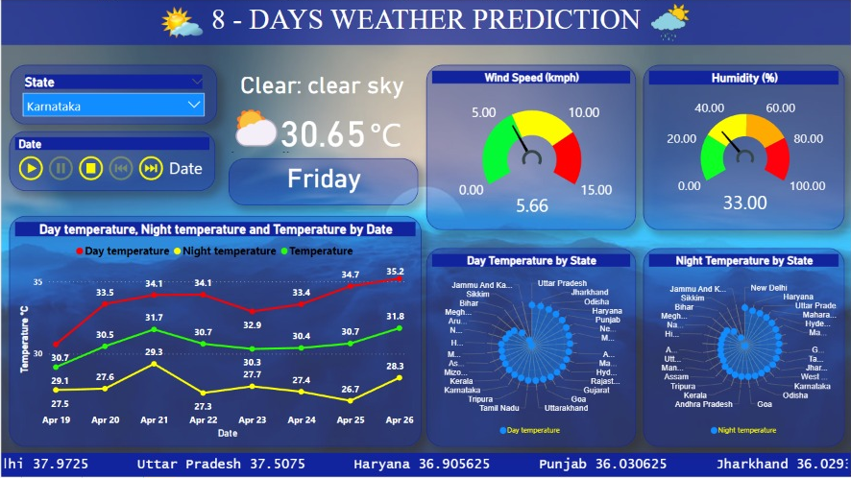

Slide 9
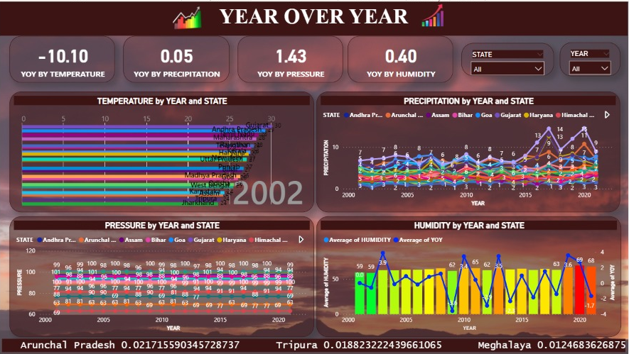

Slide 10
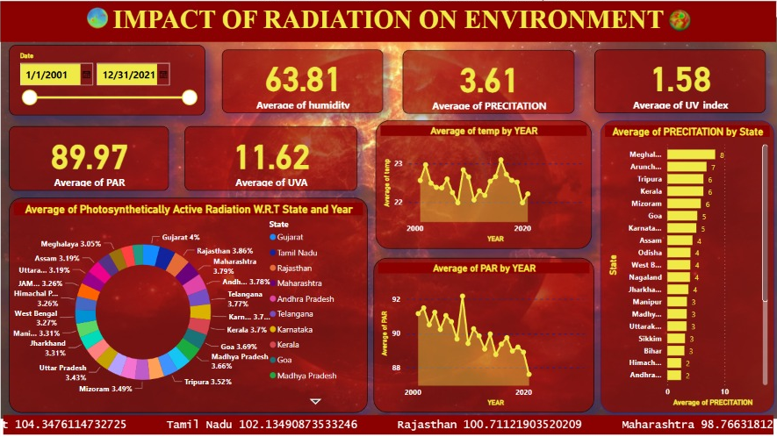

Slide 11
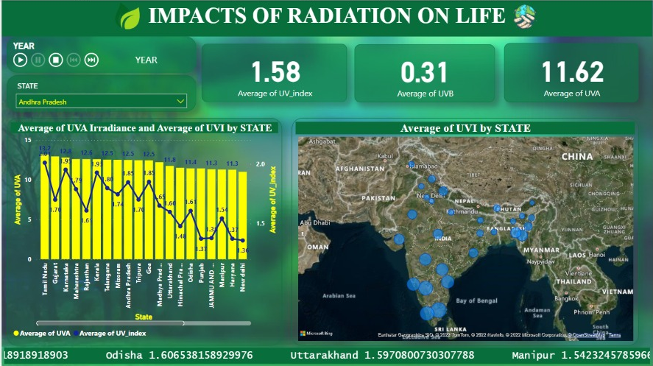

Slide 12
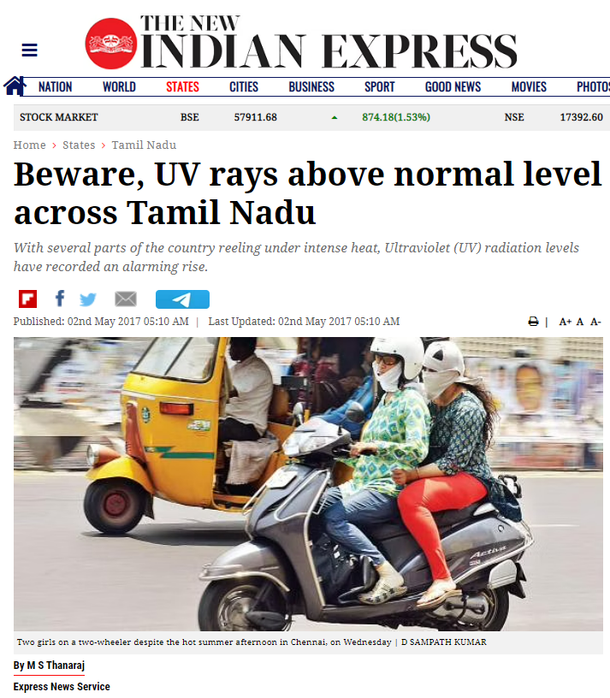
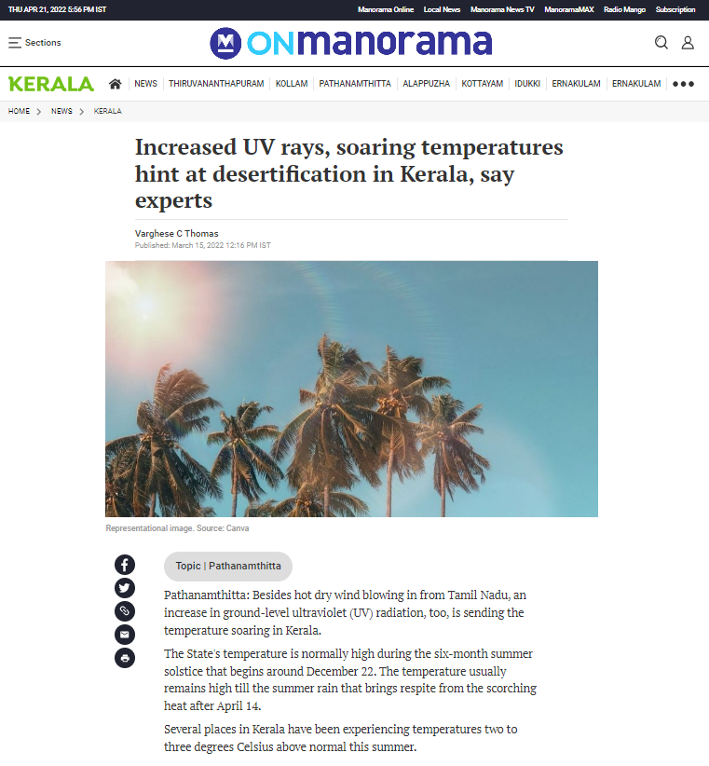
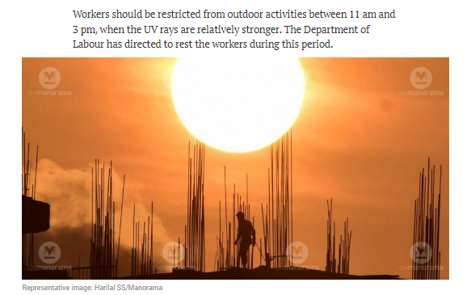
Impact of Radiation

Slide 13

Challenges Faced
Collecting the dataset which consists of all the parameters
Working Virtually
Azure Subscription
Connecting different Platforms
Usage of Heavy Application

Slide 14
1
Real time visual of climate for all parts of the world
2
Weather forecast for providing near real time natural calamities
Future Scope
3
Making a ml developed model for real time weather forecast for next 15 days
4
Analyzed data can be used to take measures regarding protection of environment
5
Visualized data can be used for taking precaution against radiation

Slide 15




Thank You!!!

